Slide 1
Development of the Spirit
Courtesy of Nicolai Levashov

Slide 2
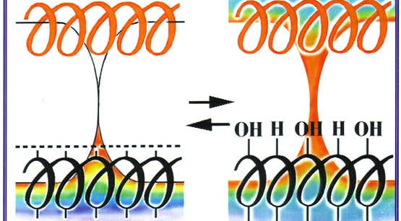
Virus Activation

Slide 3
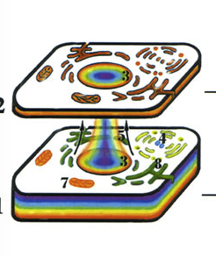
Etheric Body

Slide 4
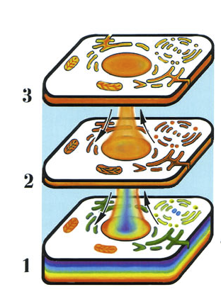
Astral Body

Slide 5
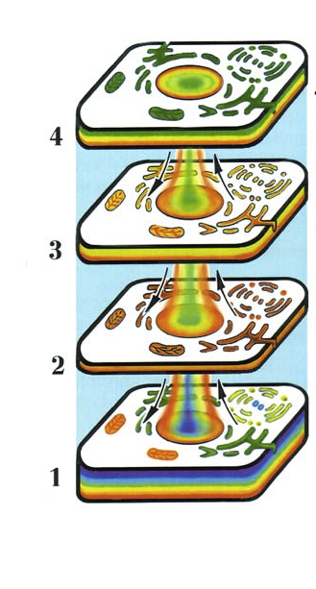
Mental Body

Slide 6
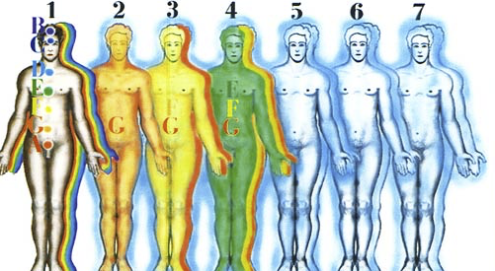
Spiritual Bodies

Slide 7
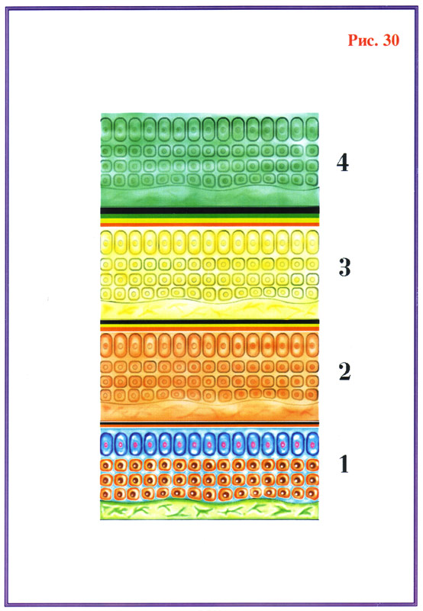
Healthy Tissue

Slide 8
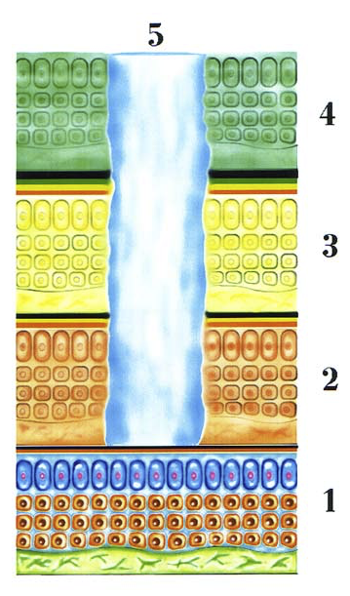
Cancer Erodes Spiritual Bodies

Slide 9
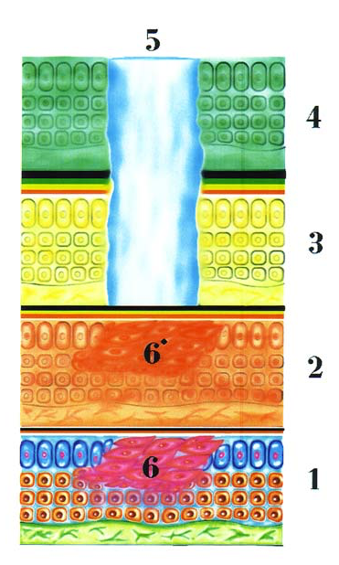
Cancer in Physical & Etheric Bodies

Slide 10
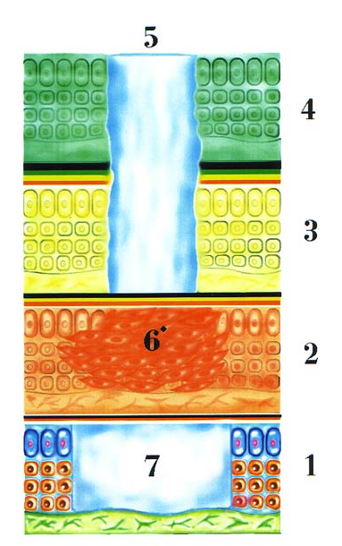
Cancer Remains in Etheric Body

Slide 11
Return of Cancer in Physical Body

Slide 12
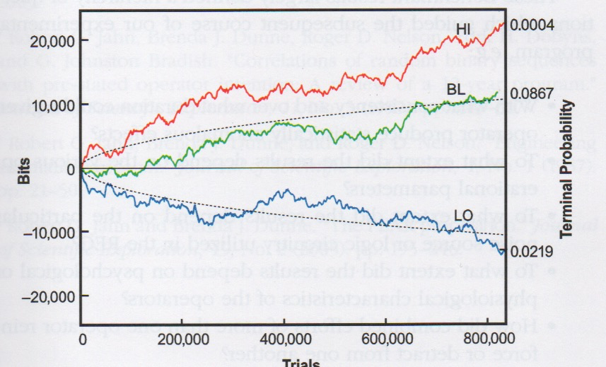
REG with Intention

Slide 13
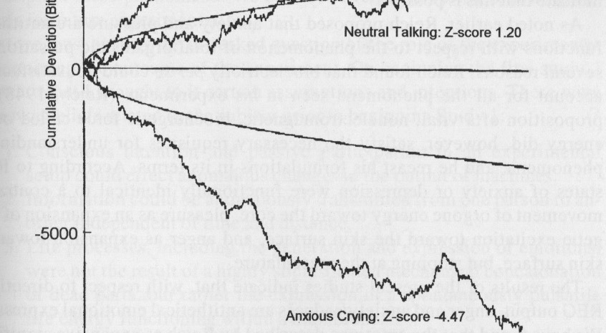
EmotREG

Slide 14
Levashov.info

