Slide 1
WebSite Progress
Delivering Added Value To Members

Slide 2
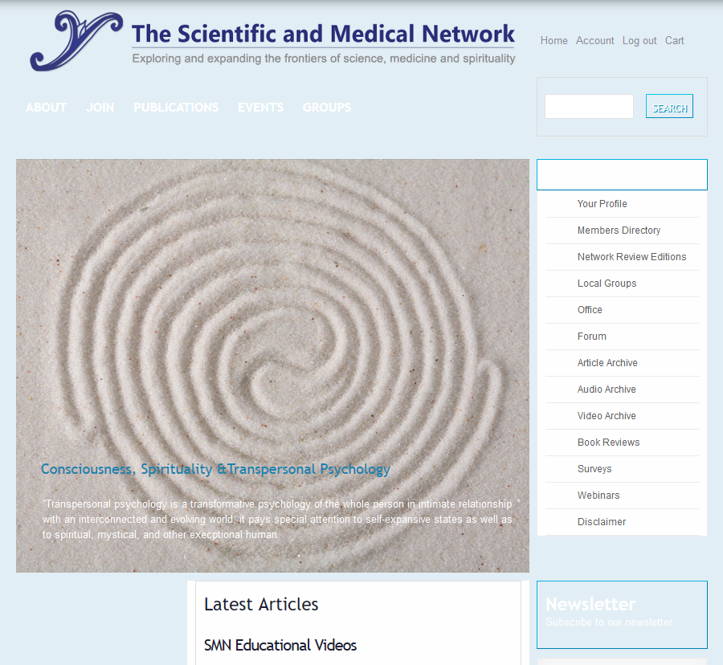
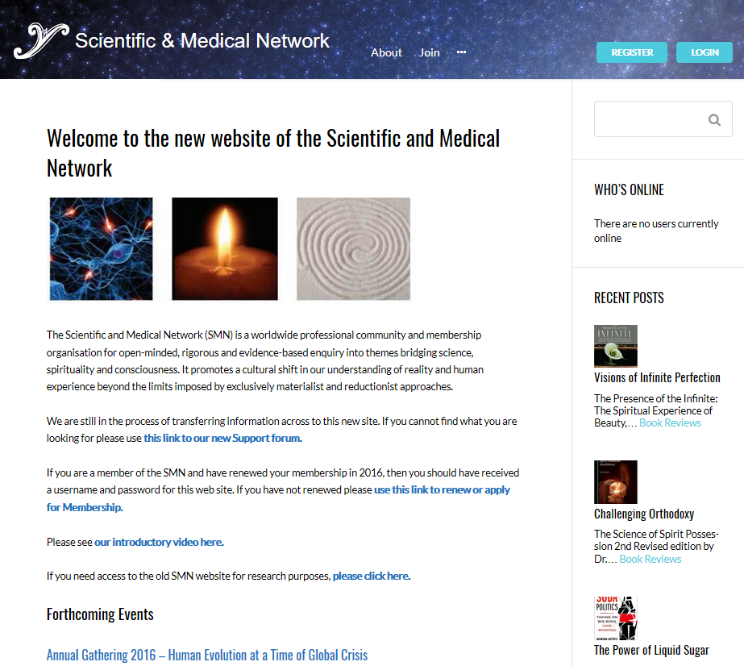
We Have ReplaceD The WebSite
Notes:
Regrettably the last the previous implementation of the SMN web site was unstable, difficult to manage and could not do everything we wanted to do as an organisation. The decision was reluctantly taken to replace the system and transfer was forced upon us in May this year as we became unable to add new content.

Slide 3
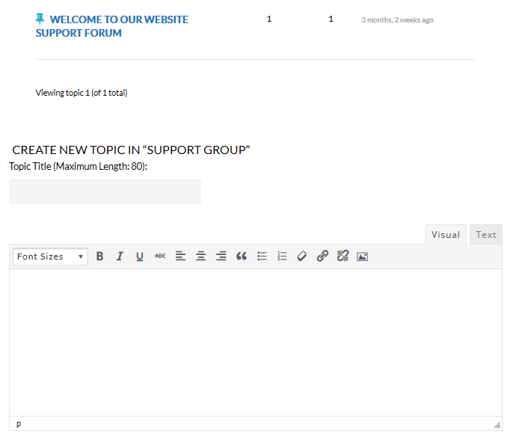
Support Forum
Notes:
Some people have difficulties with the web site and we have created a support forum both to address those issues and to allow people to request new content to be added, or existing content corrected.

Slide 4
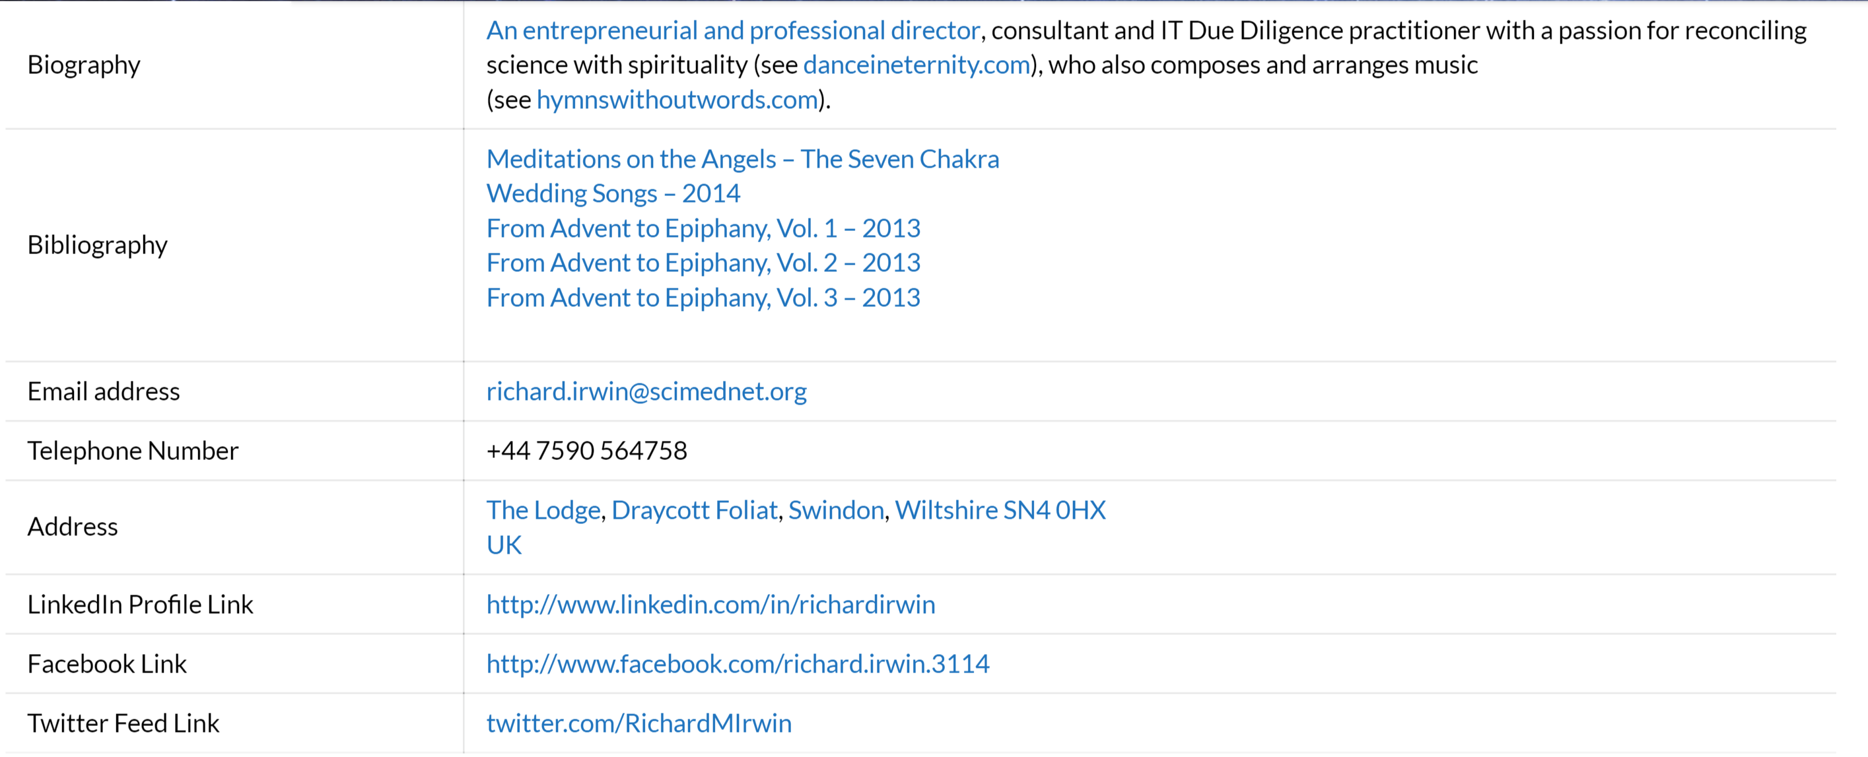
Community – Members’ Directory
Notes:
One important element that was missing from the previous web site was a proper Members’ Directory. We have now implemented this – there are still a couple of bugs to iron out, but all members will be invited to add update their profile details. Joining the Members Directory is voluntary, it is only visible to other members, and allows people with similar interests to connect and communicate and create their own discussion forums.

Slide 5
Special Interest Groups

Slide 6
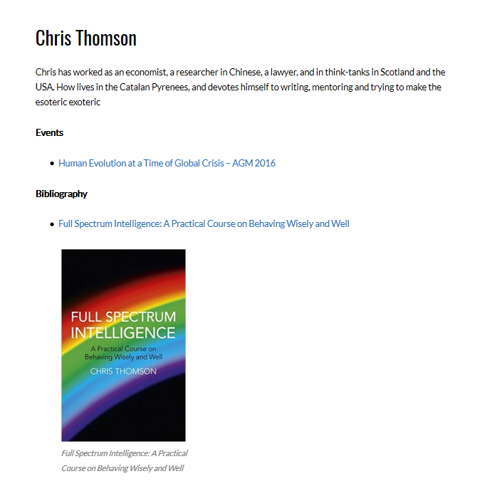
Added Value For Members – Sell Books
Notes:
We have the ability to promote books. If, as a member, you would like to be able to sell your books through the web site, complete your profile and then one of the web team can add the links to either Amazon internationally, or to your own links. That can be done through a request to the support forum.

Slide 7
Promote and sell Events and Courses

Slide 8
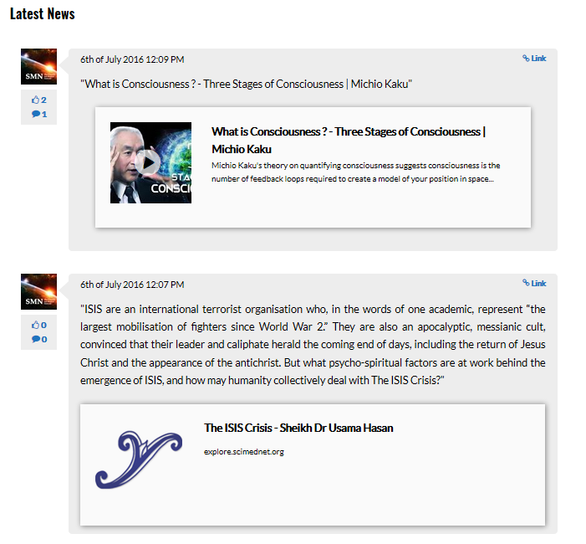
Integration With FaceBook

Slide 9
Future Plans
On-line learning platform supporting Member’s courses.

Slide 10
Offer Video and Audio

Slide 11
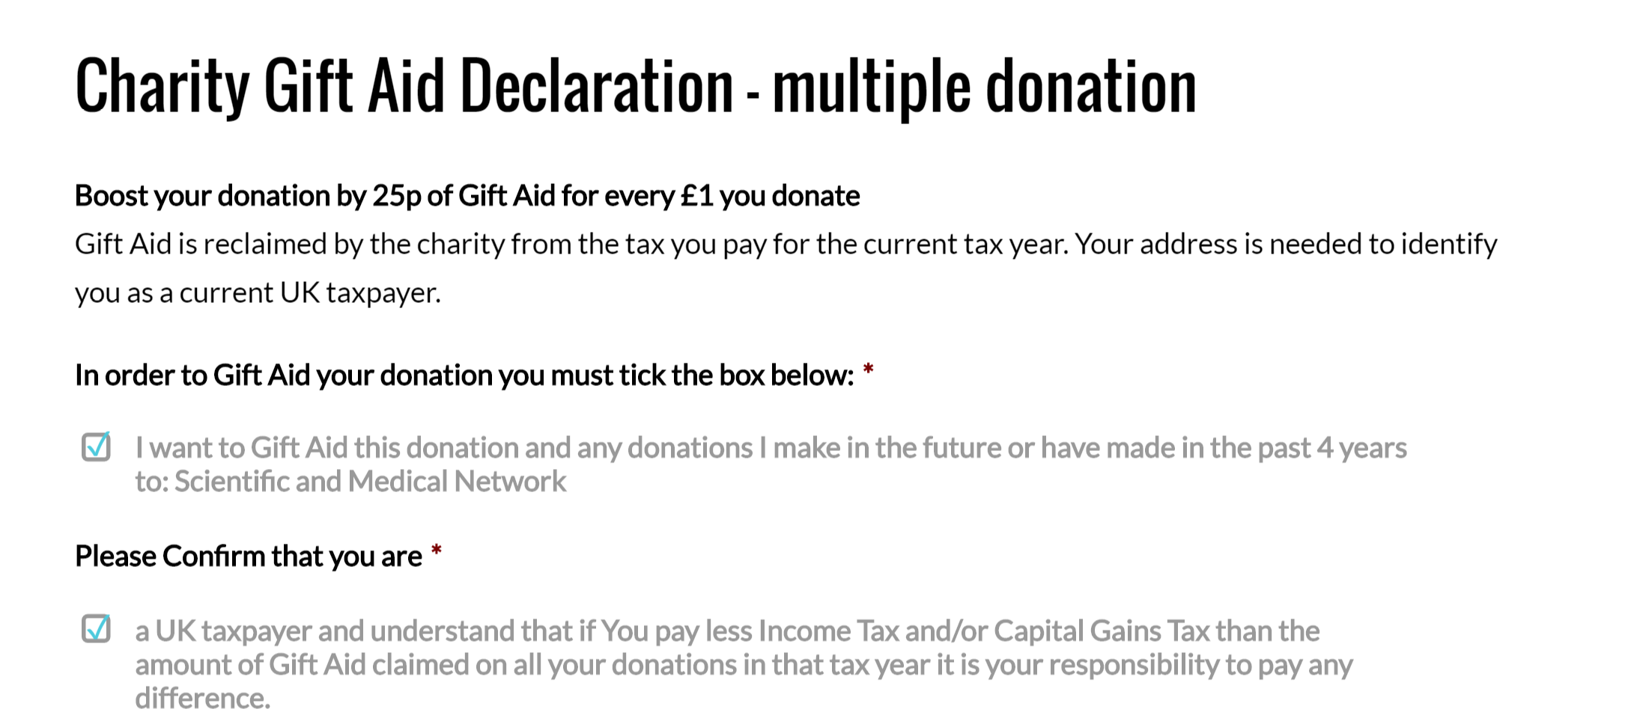

Slide 12
Common Problems
Windows XP – out of date security protocols means that Windows Explorer cannot connect to the web site.
Windows 10 – Microsoft Edge web browser does not follow proper protocols and can cause log-in problems – please use Windows Explore, Firefox or Chrome.

Slide 13
Whoops! – Snagging Problems

